Slide 1
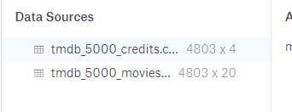

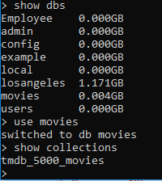

Data set-tmdb_5000

Slide 2
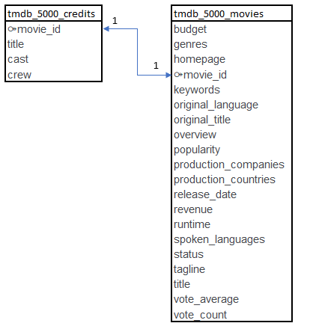
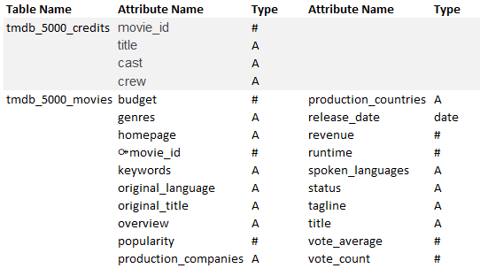
The database

Slide 3
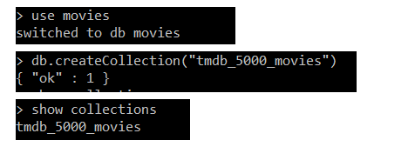

mongo-db

Slide 4
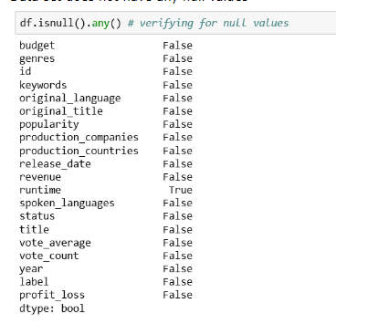
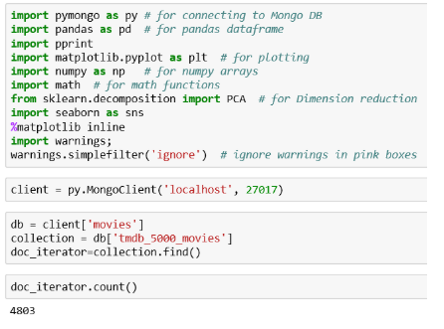
Connecting to Mongo DB from Python:

Slide 5
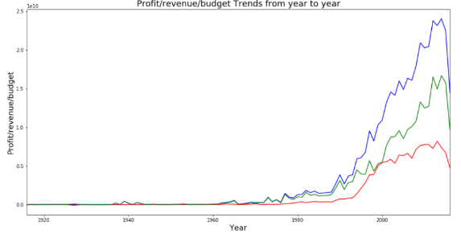
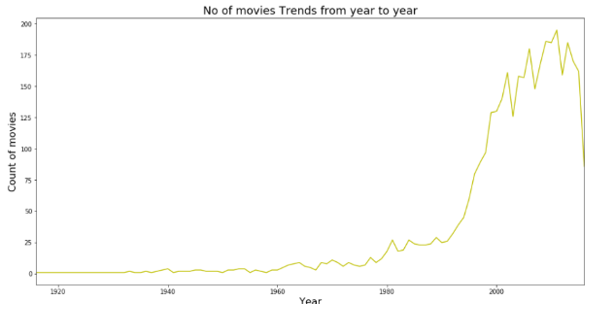
Exploratory Analysis

Slide 6
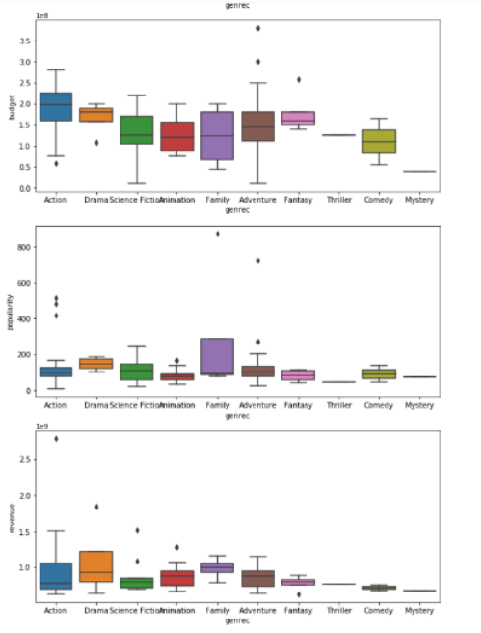
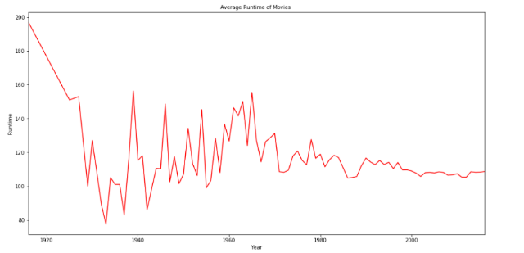
Exploratory Analysis cont’d

Slide 7
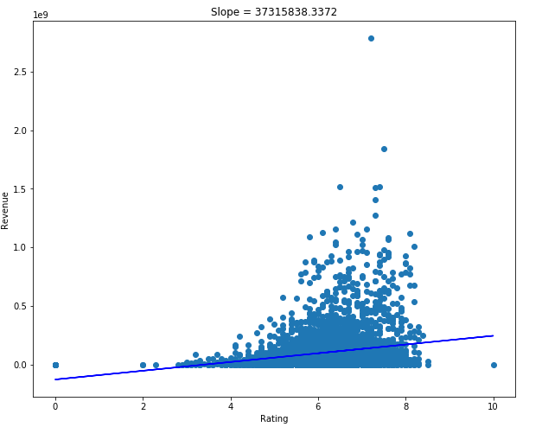
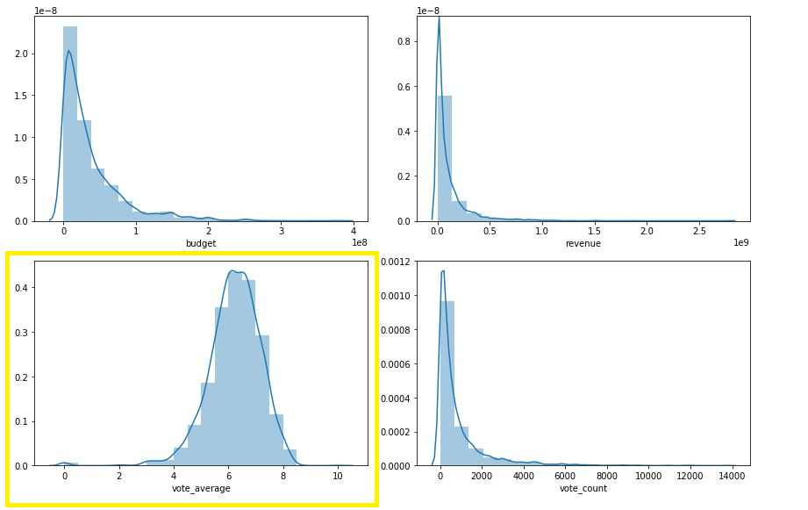
Exploratory Analysis cont’d

Slide 8
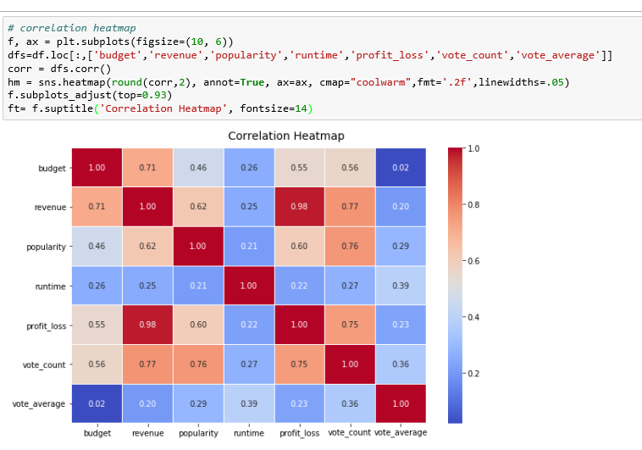
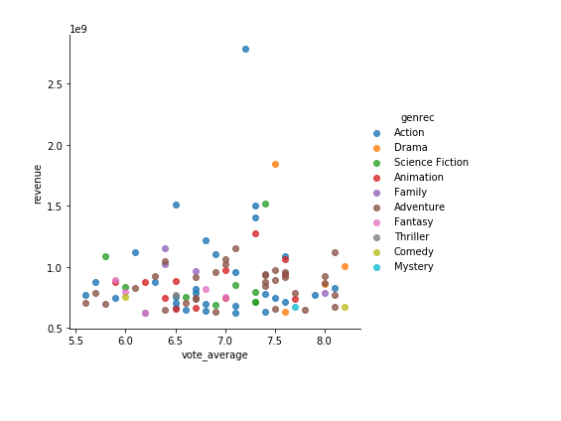
Exploratory Analysis cont’d

Slide 9
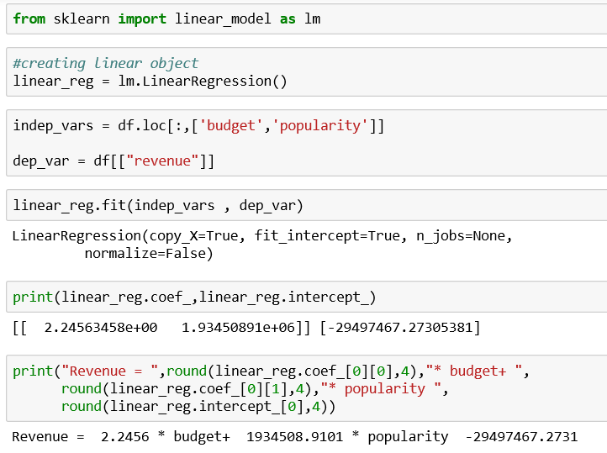
Linear regressions Analysis
Intercept -29497467.2731 indicates y- intercept value when all other variables are zero
Coefficient estimate budget 2.2456indicates, while keeping all other variables constant a unit increase in budget will increase Revenue by 2.2456
coefficient estimate popularity 1934508.9101 indictates, while keeping all other variables constant a unit increase in popularity will increase revenue by 1934508.9101

Slide 10

Random forest Analysis

Slide 11
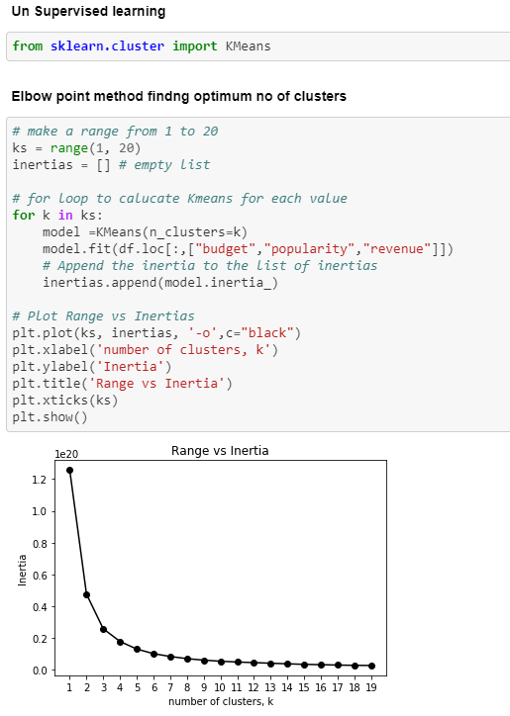
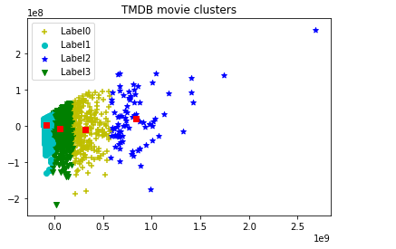
Unsupervised learning

